Slide 1
Boosting Algorithm – Regression
Ada Boosting
XG Boosting
LG Boosting

Slide 2
Ada Boosting
Boosting is an ensemble learning technique that combines multiple weak learners to create a strong learner.
AdaBoost, short for Adaptive Boosting, is a popular boosting algorithm that adapts by focusing more on the examples that are hard to classify.
AdaBoost works by iteratively training a sequence of weak learners. In each iteration, it adjusts the weights of incorrectly classified instances to focus more on them in the subsequent iteration.

Slide 3
Ada Boosting
An AdaBoost regressor:
Also known as Adaptive Boosting - is an ensemble method utilized for classification tasks.
An AdaBoost regressor is a meta-estimator
AdaBoost works by weighting the instances in the training dataset based on the accuracy of previous classifications.
The basic concept behind Adaboost is to set the weights of classifiers and training the data sample in each iteration such that it ensures the accurate predictions of unusual observations. Any machine learning algorithm can be used as base classifier if it accepts weights on the training set.

Slide 4
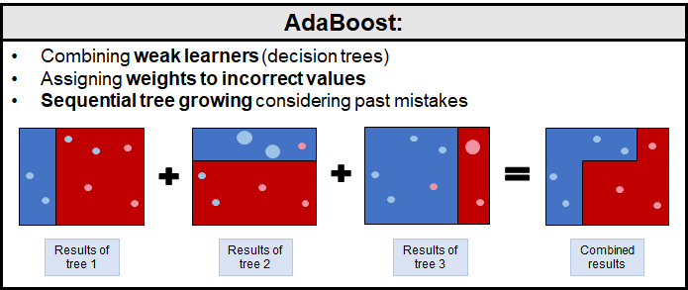

Slide 5
XG Boosting
XGBoost, which stands for Extreme Gradient Boosting, is a scalable, distributed gradient-boosted decision tree (GBDT) machine learning library.
Gradient boosting is a machine learning technique for regression and classification problems, which builds models in a stage-wise manner.
XGBoost is an efficient and scalable implementation of gradient boosting machines, developed by Tianqi Chen.
Speed and performance: Optimized for speed and efficiency.
Regularization: Provides regularization to avoid overfitting.
Flexibility: Supports custom optimization objectives and evaluation criteria.
Handling missing values: Built-in capability to handle missing data.

Slide 6
XG Boosting
XGBoost, which stands for Extreme Gradient Boosting, is a scalable, distributed gradient-boosted decision tree (GBDT) machine learning library.
Gradient Boosting for classification.
This algorithm builds an additive model in a forward stage-wise fashion; it allows for the optimization of arbitrary differentiable loss functions. In each stage n_classes_ regression trees are fit on the negative gradient of the loss function, e.g. binary or multiclass log loss. Binary classification is a special case where only a single regression tree is induced.

Slide 7
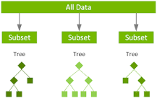

Slide 8
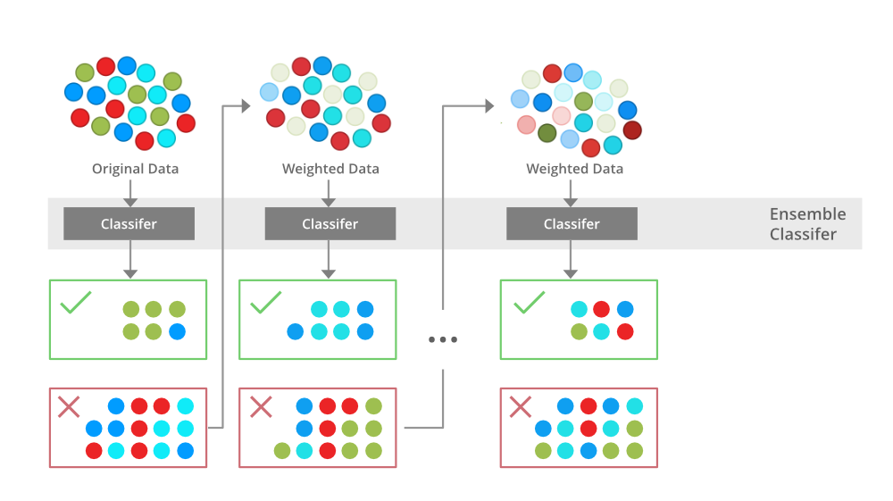

Slide 9
LG Boosting
LightGBM is an open-source, distributed, high-performance gradient boosting framework developed by Microsoft. It is designed for efficiency, scalability, and accuracy.
Recap of gradient boosting and its iterative approach to ensemble learning.
LightGBM is a gradient boosting framework developed by Microsoft, known for its efficiency and speed.
Leaf-wise tree growth: Grows trees leaf-wise instead of level-wise, leading to better accuracy.
Histogram-based algorithm: Reduces memory usage and speeds up training.
Support for large datasets: Handles large-scale datasets efficiently.

Slide 10
LG Boosting
LightGBM is an open-source, distributed, high-performance gradient boosting framework developed by Microsoft. It is designed for efficiency, scalability, and accuracy.
It is based on decision trees designed to improve model efficiency and reduce memory usage. It incorporates several novel techniques, including Gradient-based One-Side Sampling (GOSS), which selectively retains instances with large gradients during training to optimize memory usage and training time. Additionally, LightGBM employs histogram-based algorithms for efficient tree construction.
These techniques, along with optimizations like leaf-wise tree growth and efficient data storage formats, contribute to LightGBM’s efficiency and give it a competitive edge over other gradient boosting frameworks.

Slide 11
